Slide 1

SQL: Social Media Project
Thode rohith
10/12/2025

Slide 2
Introduction & Problem Statement
I as a data analyst at Meta, am asked to collaborate with the marketing team to leverage Instagram's user data to develop targeted marketing strategies that will increase user engagement, retention, and acquisition.
It will also provide insights and recommendations to address the following objectives.

Slide 3
Data Overview
There are 7 tables in the dataset –
users, photos, comments, follows, likes, tags and photo_tags.
This dataset contains information about 100 users, 257 photos, 1000 comments and 21 hashtags.
Good quality data is very essential to analyze user behavior.

Slide 4
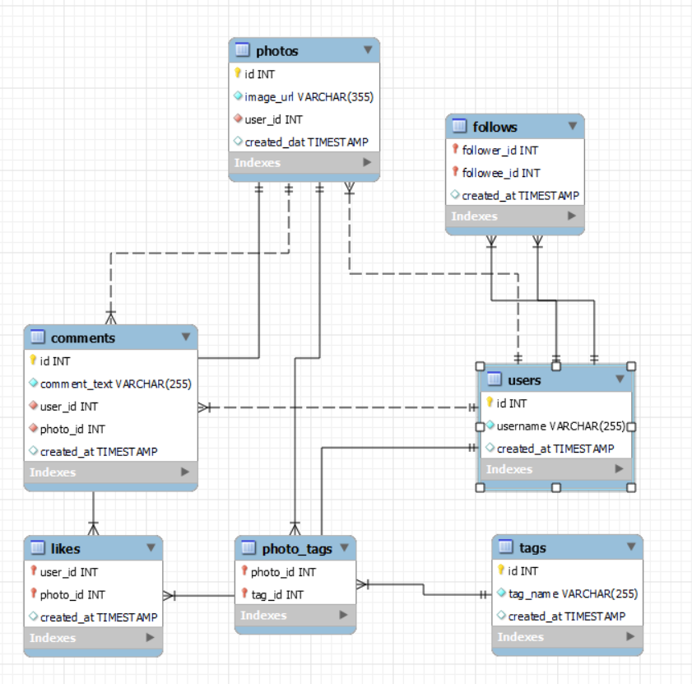
Database Schema

Slide 5
Analytical Methods
I have calculated key metrics like activity score and divided the user base into different segments based on their engagement through posts, likes and comments.
Used subqueries, CTEs and joins to calculate the activity score, average engagement rates, number of followers and following, etc.

Slide 6
User Activity Insights
We have calculated activity score of each user based on the number of posts, likes of comments they have made.
Based on the activity score, we have divided the users into 4 segments-Highly active, moderately active, low activity and inactive.
Activity Level | Score Range
Highly Active | > 400
Moderately Active | 201–400
Low Activity | 1–200
Inactive | 0

Slide 7
We found that there are 13 highly active users, 64 moderately active users ,10 low active users and 13 inactive users.
We can reward active users through incentives like badges, exclusive features, or even early access programs.
We can retarget inactive users with personalized content and suggestions.

Slide 8
Hashtag Analysis
There are 21 hashtags in total that have been used by users.
Used count function to determine the number of times each hashtag has been used in photos.
#smile hashtag is the highest used hashtag with usage in 59 photos.
It is followed by #beach, #party and #fun hashtags which are used in 42, 39 and 38 photos respectively.
We need to prioritize creating or boosting content that uses hashtags with proven engagement.

Slide 9
We need to launch challenges, story templates, or reels using top hashtags.
We need to target audiences that frequently engage with top hashtags.
Run hashtag-specific ad-campaigns to boost discoverability.

Slide 10
Influencer Identification
Social media influencers are vital for the growth of the platform.
We have identified potential users who could be influencers.
An influencer should have high followers and a high engagement rate.
Highly active users who consistently post and engage are ideal for community building or ambassador programs.
We identified 13 users who match our criteria.

Slide 11
UserName | Followers | Activity_score | Activity_level
Jaclyn81 | 76 | 1028 | high active
Rocio33 | 76 | 1028 | high active
Maxwell.Halvorson | 76 | 1028 | high active
Ollie_Ledner37 | 76 | 1028 | high active
Mckenna17 | 76 | 1028 | high active
Duane60 | 76 | 1028 | high active
Julien_Schmidt | 76 | 1028 | high active
Mike.Auer39 | 76 | 1028 | high active
Nia_Haag | 76 | 1028 | high active
Leslie67 | 76 | 1028 | high active
Janelle.Nikolaus81 | 76 | 1028 | high active
Bethany20 | 76 | 1028 | high active
Aniya_Hackett | 76 | 1028 | high active

Slide 12
They have 76 followers each and activity score of more than 1000 which comes under high activity.
We can approach the users/ influencers through DM or email and highlight what is in it for them (monetary, product gifts, visibility).
Campaigns could include sponsored content, giveaways, or product reviews, and I would track performance using promo codes or UTM links to measure ROI.

Slide 13
Inactive Likers
Users who are not present in the likes table are the users who have never liked a post.
We found that there are 13 users who have never liked any post since they have joined our platform.
This shows that their content recommendations are not up to their liking.
We need to improve our algorithm so that the users get to interact with posts which they have interest in.

Slide 14
Recommendations for Engagement
Highly Active Users:
  Reward with badges, exclusive features, or early access.
  Offer discount codes, shoutouts, or leaderboard placement.
Inactive Users (13 identified):
  Send personalized email/push campaigns.
  Recommend content based on past interests (hashtags, likes).
  Highlight trending posts or creators.
Hashtag Campaigns:
  Boost content with high-engagement hashtags (#smile, #beach).
  Launch challenges or reels using popular hashtags.

Slide 15
Limitations
  No demographic data (age, gender, location) or posting time variability.
  Limited content type data (photos vs. videos/reels).
  No data on ad campaigns(impressions, clicks, conversions).

Slide 16
Opportunities
  Collect demographic and timestamp data for deeper segmentation.
  Analyze video/reel engagement for content-specific strategies.
  Integrate ad campaign data (impressions, clicks) for ROI analysis.

Slide 17
Conclusion
Implement reward programs for highly active users.
Launch re-engagement campaigns for inactive users.
Initiate hashtag-based ad campaigns (#smile, #beach).
Partner with identified influencers for pilot campaigns.
Enhance dataset with demographic and ad performance data.

Slide 18
Thank You

